Slide 1
Flood Probability Regression with a Hybrid Ensemble w/ Uncertainty Quantification
By: Vatsal Sivaratri and Connor Friedman

Slide 2
Problem Statement and Motivation
Goal: Develop a predictive, robust model(s) for determining the likelihood of a flood (percent chance of an area to flood)
Motivation: Flood frequency and severity has been rising due to climate change. Reliable systems that can predict these events in advance can help communities plan and mitigate disasters.
Notes:
Connor

Slide 3
Understanding Uncertainty in Predictions
Machine Learning models make predictions, but how confident are they?
A prediction of 80% flood risk means something entirely different if the model is highly confident vs. uncertain
Types of Uncertainty:
Aleatoric Uncertainty (Data Uncertainty): Noise in the data; Inherent to the task
Epistemic Uncertainty (Model Uncertainty): How much the model doesn’t know due to a lack of training data.
Why does it matter?
High-confidence predictions -> Trust the model’s output
High-uncertainty predictions -> Need more investigation, can’t take results for face value
Proposed Approach: Compute uncertainty estimates using Monte Carlo Dropout & Bootstrap Variance in Ensemble Learning
Notes:
Vatsal

Slide 4
Dataset Source & Description
Source: Kaggle Flood Dataset
Key Details: Dataset consists of 1.12m instances and 21 features, all numerical.
Key Features:
Environmental Factors: Monsoon intensity, watershed count.
Geographic & Infrastructure: Drainage systems, river management.
Human Impact Factors: Urbanization, deforestation.
Target Variable: Flood Probability (Continuous values from 0 to 1)
Data Preprocessing:
Feature Scaling: Standardized using z-score normalization.
Outliers: Removed using IQR
Notes:
Connor

Slide 5
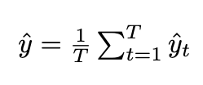

Ensemble Learning: Deep Neural Network (DNN)
Architecture:
Input Layer: 21 features
Hidden Layers: 2 Dense Layers (64->32 neurons)
Activation: ReLU
Dropout Layers: 30% dropout to improve generalization
Output Layer: Single neuron (linear activation) -> Flood Probability (0-1)
Uncertainty Estimation: Monte Carlo Dropout:
Run Model T times
Randomly drop neurons each run, giving slightly different outputs
Mean Prediction:
Uncertainty (Variance) Prediction:
If predictions vary a lot, uncertainty is high. If they are stable, uncertainty is low.
Notes:
Vatsal

Slide 6


Ensemble Learning: Gradient Boosting Machine (GBM)
How GBM Works:
Uses decision trees to repeatedly improve weak models.
Each tree focuses on correcting errors from the last one.
Outputs a weighted sum of trees.
Uncertainty Estimation: Bootstrapped Variance:
Train multiple GBM models on different randomized subsets of the data
Collect predictions from all the models and compute:
Mean
Variance
Notes:
Vatsal

Slide 7
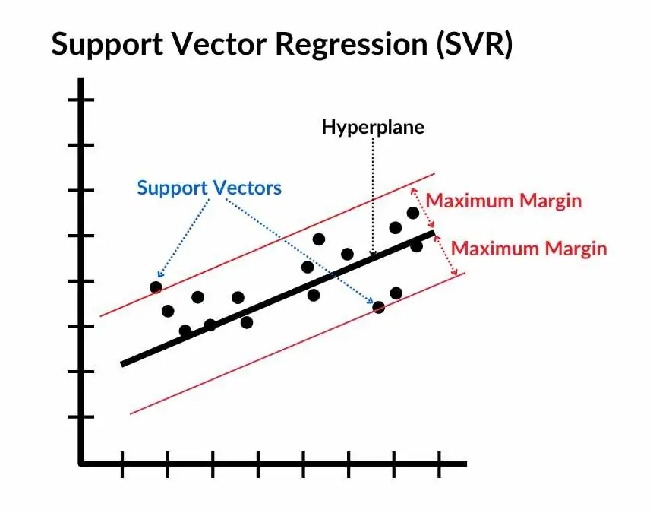
Ensemble Learning: Support Vector Regression (SVR)
How SVRs work:
Find the best hyperplane that fits the flood probability
Uses kernel trick to capture non-linearity
Uncertainty Estimation: Bootstrap Sampling
Train multiple SVR models on different resampled datasets
Use variance across models as uncertainty estimate
Notes:
Connor

Slide 8


Model Aggregation
Each model provides a prediction + uncertainty estimate.
Uncertainty-Weighted Averaging:
More confident models (lower variance) contribute more:
Final prediction:
Notes:
Vatsal

Slide 9
Performance Comparison
 | MSE | MAE | R2 Score
DNN | 0.00040 | 0.01595 | 0.84504
GBM | 0.00059 | 0.01987 | 0.77274
SVR | 0.00085 | 0.02409 | 0.67283
BayesRidge | 0.00040 | 0.01580 | 0.84434
DecisionTree | 0.00250 | 0.03979 | 0.03739
LinearReg | 0.00040 | 0.01580 | 0.84434
RandomForest | 0.00094 | 0.02503 | 0.63808
Ensemble | 0.00054 | 0.01877 | 0.79343
Notes:
Vatsal

Slide 10
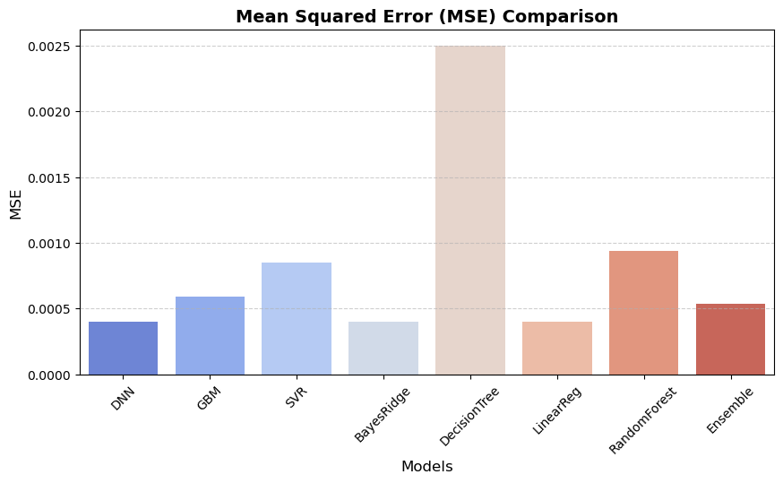
Results

Slide 11
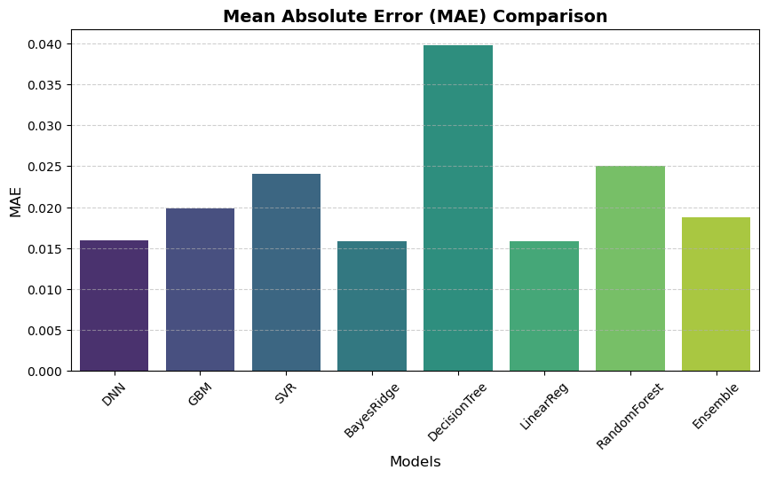
Results

Slide 12
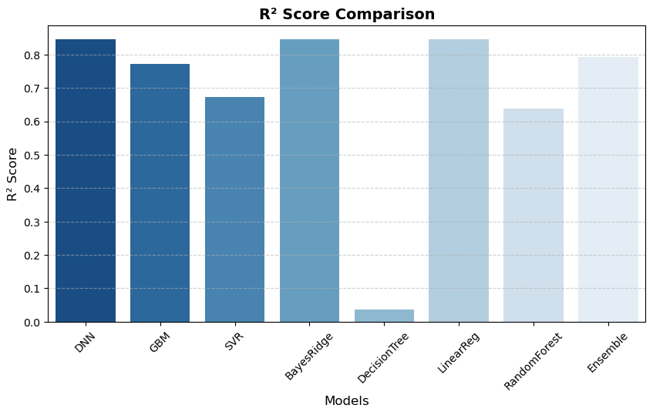
Results

Slide 13
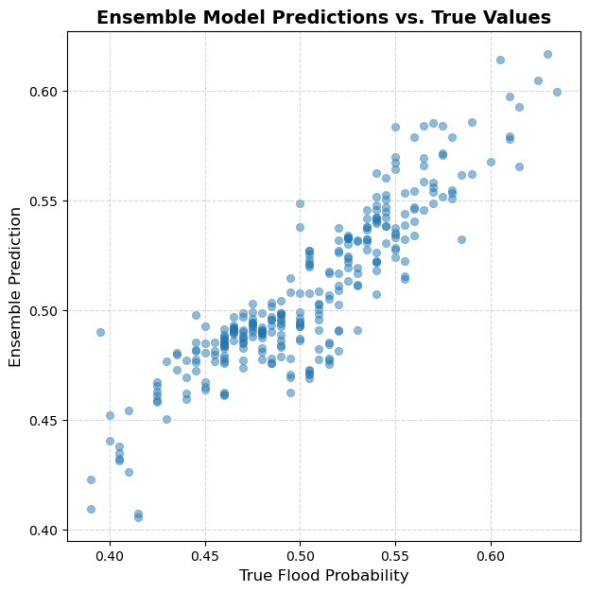
Results

Slide 14
Thanks!

